Slide 1
Effect Size Calculation

Slide 2
Measures of Effect Size
There are three common measures of effect size for the chi-square test for independence
Proportion of variance
Phi coefficient
Cramer’s V
Proportion of variance
When stated as an effect size with a chi-square test for independence, the r term is replaced with
In Example 17.2, we selected 110 participants and computed
The proportion of variance is:
Type of counseling attended accounts for 5% of total variance for completing counseling

Slide 3
Measures of Effect Size (cont.)
Phi coefficient
The square root of the proportion of variance is the phi coefficient
Using the phi coefficient to estimate effect size in Example 17.2, we take the square root of the proportion of variance:
Cramer’s V
When the levels of one or more categorical variables are greater than two, we use Cramer’s V or Cramer’s phi to estimate effect size
df-smaller is the smaller of the two df

Slide 4
Chi-Square Test in R
#chisq.test performs chi-squared contingency table tests and goodness-of-fit tests.
#https://www.rdocumentation.org/packages/stats/versions/3.4.3/topics/chisq.test
M <- as.table(rbind(c(22, 31), c(12, 45)))
dimnames(M) <- list(outcome = c("Completion", "Premature Termination"), TypeOfCounselling = c("Family","Individual"))
(Xsq <- chisq.test(M))

Slide 5
Chi-Square Test in SPSS
Hypothetical Example: Effectiveness of a Drug Treatment
Let’s consider a hypothetical case where we test the effectiveness of a drug for a certain medical condition. Suppose we have 105 patients under study and 50 of them were treated with the drug. The remaining 55 patients were kept as control samples. The health condition of all patients was checked after a week.

Slide 6
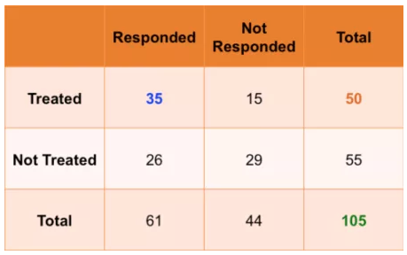
Chi-Square Test in SPSS
The following table shows if their condition improved or not.

Slide 7
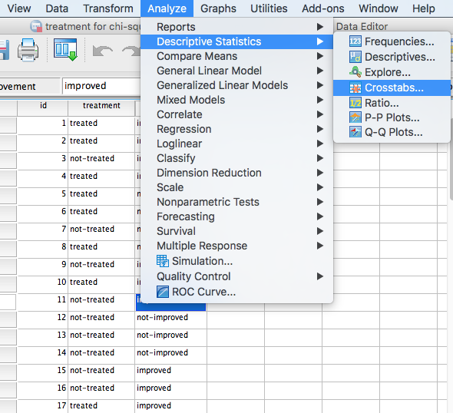
Chi-Square Test in SPSS

Slide 8
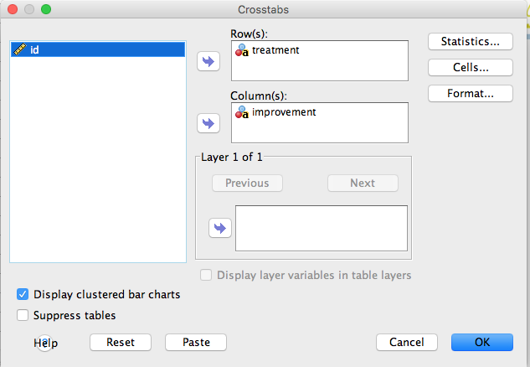
Chi-Square Test in SPSS

Slide 9
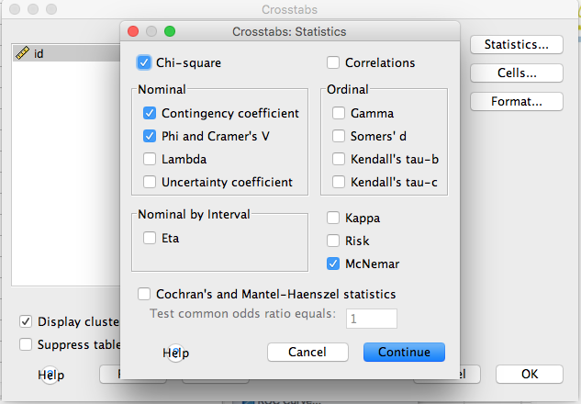
Chi-Square Test in SPSS

Slide 10
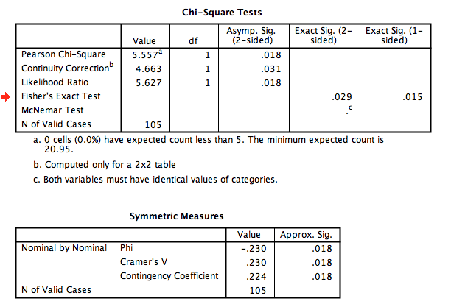
Chi-Square Test in SPSS

Slide 11
APA in Focus: Reporting the Chi-Square Test
To summarize the chi-square goodness-of-fit test, report the test statistic, df, and p value
Observed frequencies can be summarized in a figure or table or in the main text
To summarize the chi-square tests for independence, also report the effect size
Here is a summary of the results for Example 17.2, using Cramer’s V as the measured effect size:
The chi-square test for independence showed a significant relationship between the type of counseling and outcome, , . The data indicate that family involvement in counseling is associated with a greater number of patients completing counseling.

